Slide 1
Basic Electric Circuits
Superposition
Lesson 8

Slide 2
Basic Electric Circuits
Superposition :
One might read (hear) the following regarding superposition.
(1) A system is linear if superposition holds.
(2) Superposition holds if a system is linear.
This sounds a little like the saying of which comes
first, “the chicken or the egg.”
Of the two statements, I believe one should remember
that if a system is linear then superposition applies (holds).
14

Slide 3
Basic Electric Circuits
Superposition: Characterization of Superposition.
Let inputs f₁ and f₂ be applied to a system y such that,
y = k₁f₁ + k₂f₂
Where k₁ and k₂ are constants of the systems.
Let f₁ act alone so that, y = y₁ = k₁f₁
Let f₂ act alone so that, y = y₂ = k₂f₂
The property of superposition states that if f₁ and f₂
Are applied together, the output y will be,
y = y₁ + y₂ = k₁f₁ + k₂f₂
13

Slide 4
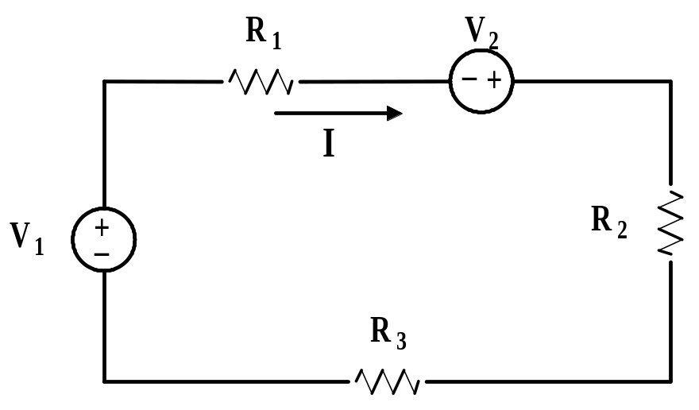
Basic Electric Circuits
Superposition: Illustration using a circuit.
Consider the circuit below that contains two voltage sources.
Figure 9.4: Circuit to illustrate superposition
We assume that V₁and V₂ acting together produce current I.
15

Slide 5
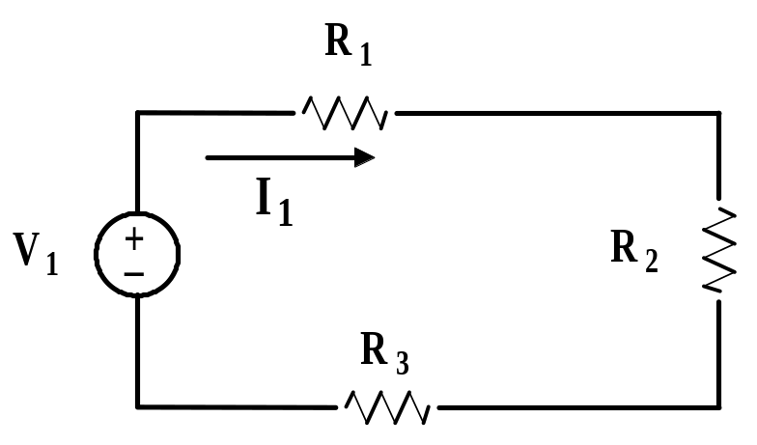
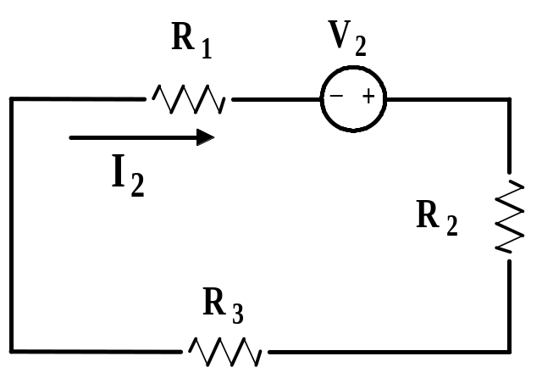
Basic Electric Circuits
Superposition: Illustration using a circuit.
V₁ produces current I₁
V₂ produces current I₂
Superposition states that the current, I, produced by both
sources acting together (Fig 9.4) is the same as the sum of
the currents, I₁ + I₂, where I₁ is produced by V₁ and I₂ is
produced by V₂.
16

Slide 6
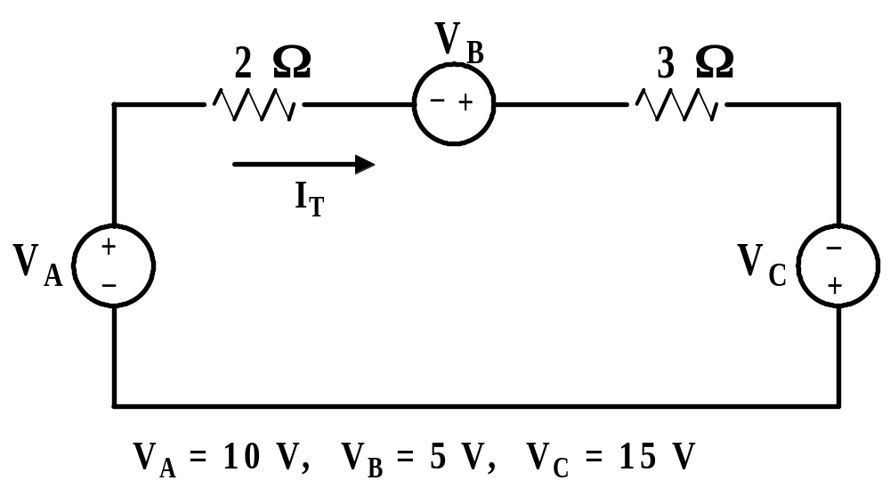
Basic Electric Circuits
Superposition: Example 9.3. Given the circuit below.
Demonstration by solution that superposition holds.
Figure 9.5: Circuit for Example 9.3
With all sources acting: I_{L} = 6 A
17

Slide 7
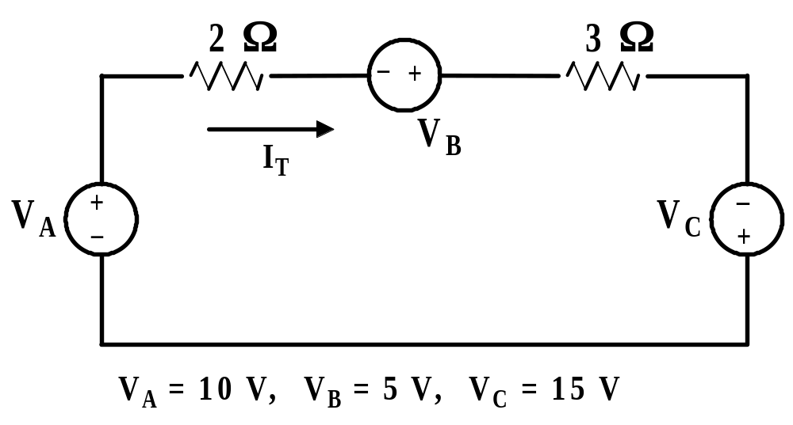
Basic Electric Circuits
Superposition: Example 9.3. Given the circuit below.
Demonstration by solution that superposition holds.
With V_{A} + V_{B} acting, V_{C} = 0: I_{A+B} = 3 A
,
With V_{C} acting, V_{A} + V_{B} = 0: I_{C} = 3 A
We see that superposition holds.
18

Slide 8
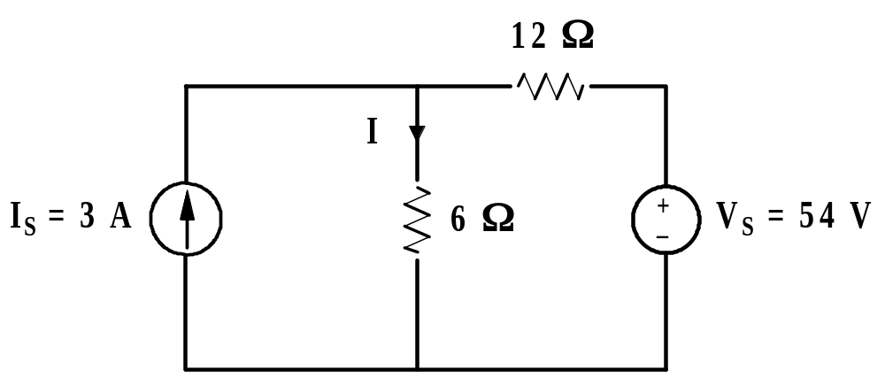
Basic Electric Circuits
Superposition: Example 9.4. Given the circuit below.
Find the current I by using superposition.
Figure 9.5: Circuit for Example 9.4.
First, deactivate the source I_{S} and find I in the 6 Ω resistor.
Second, deactivate the source V_{S} and find I in the 6 Ω resistor.
Sum the two currents for the total current.
19

Slide 9
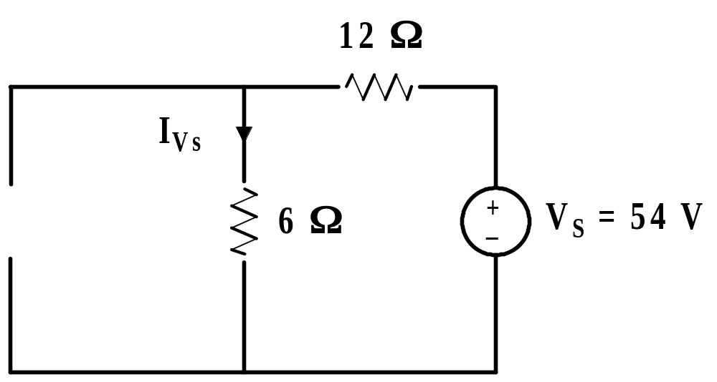
Basic Electric Circuits
Superposition: Example 9.4. Given the circuit below.
Find the current I by using superposition.
I_{Vs} = 3 A
20

Slide 10
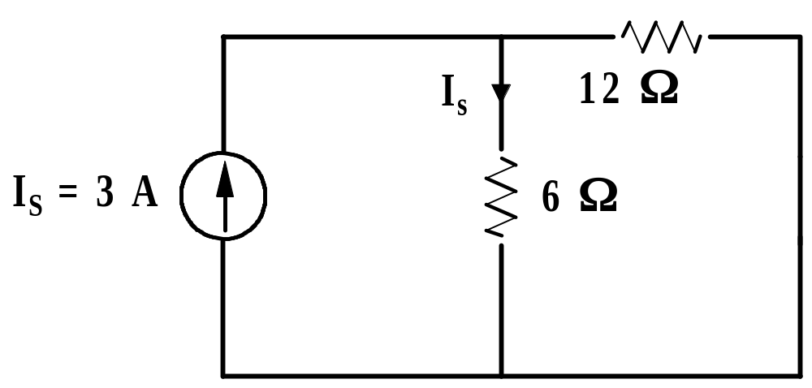
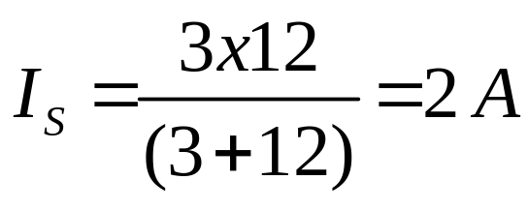
Basic Electric Circuits
Superposition: Example 9.4. Given the circuit below.
Find the current I by using superposition.
Total current I: I = I_{S} + I_{vs} = 5 A
21

Slide 11

CIRCUITS
End of Lesson 9
Linearity and Superposition

